Slide 1

DATA SCIENCE PROJECT
NBA

Slide 2
STUDENTS
Shahar Cohen, 204593594
Bar Cohen, 316564087
David Alishayev, 327226924

Slide 3
Project Breakdown
Step 1+2 – Crawling + Scrub
crawling from ‘ESPN’ NBA players stats from 15/16 Season Table to 21/22 Total of 7 Seasons Examination of the data After first examination – adding ‘Season’ column data Saving the data as csv ‘DataFrameNBATeams’ to avoid repeating crawling process
Step 3 - Explorer
Examination of the full data as csv New DataFrame for each player and his season number Added new ‘Seasons Played’ column to original DataFrame Summing the player's stats Averaging the player’s stats according to his seasons count Checking outliers and missing data and replacing it with the column’s mean Divided DataFrame to 3 different DataFrames according to our machine learning questions
Step 4 – Models
Examining the data by 2 different models Logistic Regression SVC Model Use of models Logistic Regression- Predict the minimum amount of: ‘Field Goals %’ ‘Points’ ‘Rebounds’ ‘Blocks’ ‘Assists’ Predict the best player for every ML question SVC Model Predict the best player for every ML question
Step 5 – interpret
Examining the result of each model Visualizing the result of each model

Slide 4

FIRST STEP - CRAWLING

Slide 5
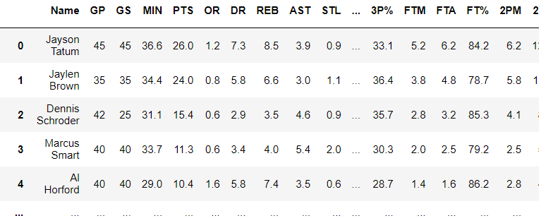
CREATING THE DATAFRAME
crawling from ‘ESPN’ NBA players stats from 15/16 Season Table to 21/22, Total of 7 Seasons
Our DataFrame:
4135 rows × 30 columns

Slide 6
Crawling NBA Base Data from ESPN
- Crawling using BeautifulSoap
- Creating Data Frame which contains the whole data from the last 7 seasons
- Averaging the player’s stats
- Added ‘Season Played’ column

Slide 7
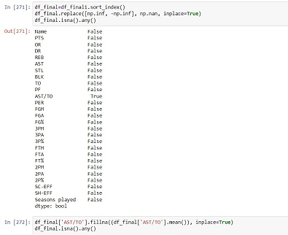
Data Cleaning
Checking if there’s an outliers or missing data
Replacing them with the column’s mean

Slide 8

Exploratory data analysis

Slide 9
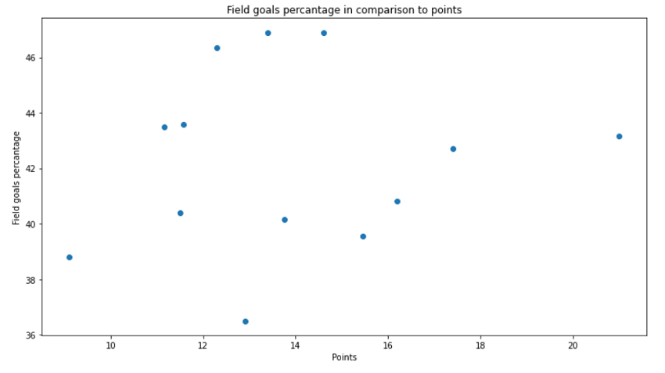
Field goals percentage in comparison to points (Rookie dataframe)

Slide 10
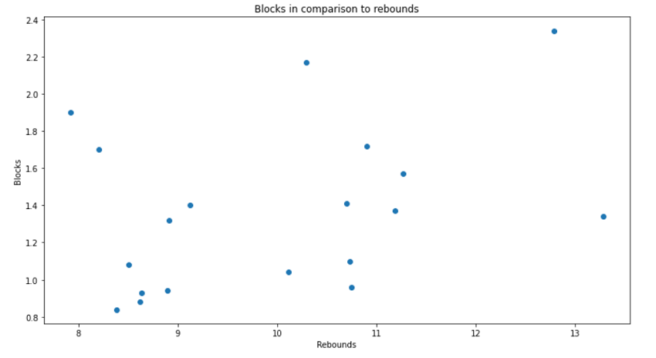
Blocks in comparison to rebounds (Defensive players dataframe)

Slide 11
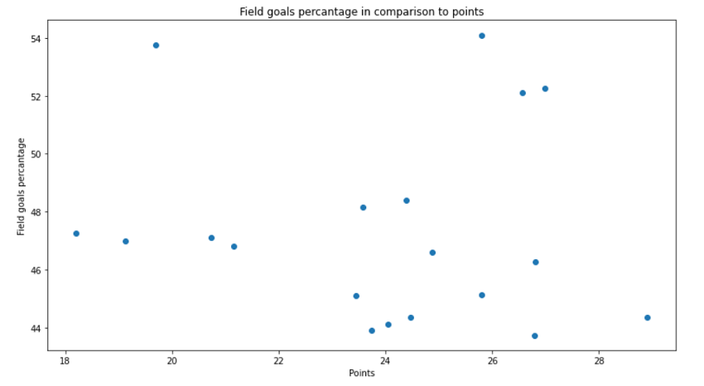
Field goals percentage in comparison to points (MVP dataframe)

Slide 12
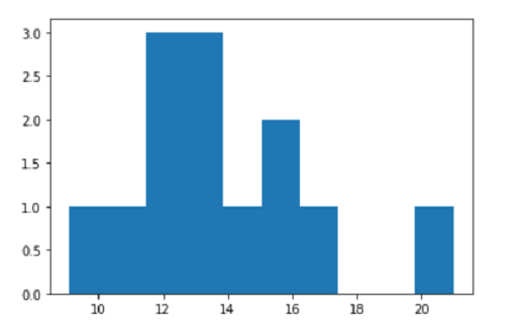
Points Histogram (Rookie dataframe)

Slide 13
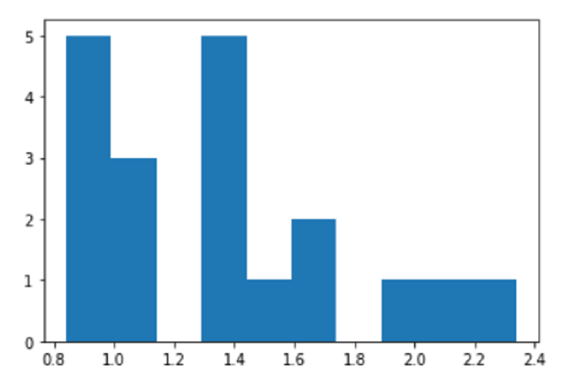
Blocks Histogram (Defensive players dataframe)

Slide 14
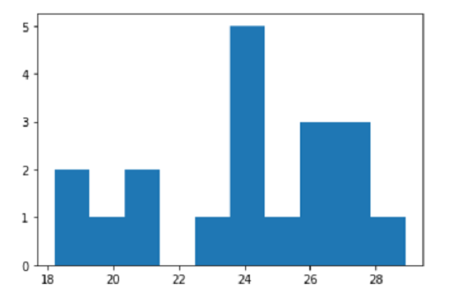
Points Histogram (MVP dataframe)

Slide 15
SECOND STEP - EVALUATE
- After crawling the data and getting the information that we need,
- let find and predict:
* Who will be the rookie of the year?
* Who will be the defensive player of the year?
* Who will be the MVP of the year?

Slide 16
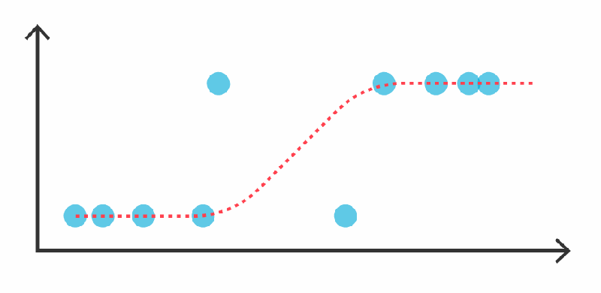
MODELS USED
Logistic Regression
SVC Model

Slide 17

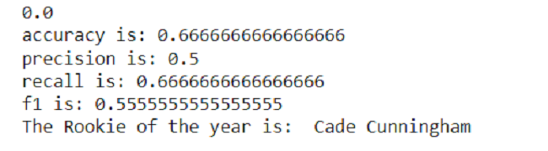
Predict the minimum amount of: field goal %, rebounds, blocks, assists required to be the rookie of the year!

Slide 18

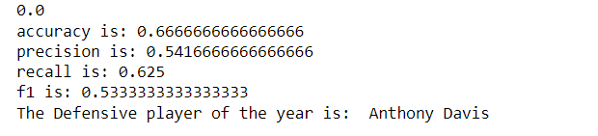
Predict the minimum amount of: field goal %, points, blocks, assists required to be the defensive player of the year!

Slide 19

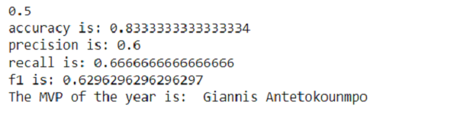
Predict the minimum amount of: field goal %, rebounds, blocks, assists required to be the MVP of the year!

